Slide 1
Electronic Devices
Mid Term Lecture - 03
Reference book:
Electronic Devices and Circuit Theory
Robert L. Boylestad and L. Nashelsky , (11th Edition)

Slide 2
Electronic Devices
CHAPTER 2 DIODE APPLICATIONS
Reference book:
Electronic Devices and Circuit Theory
Robert L. Boylestad and L. Nashelsky , (11th Edition)

Slide 3
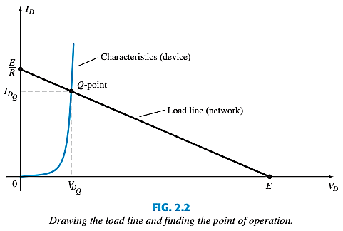
LOAD-LINE ANALYSIS

Slide 4

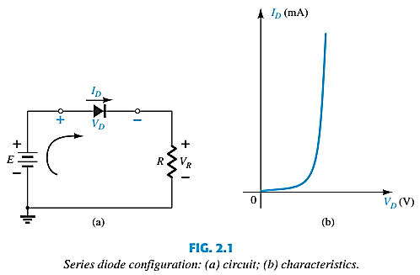
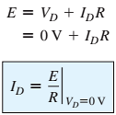
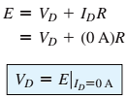
LOAD-LINE ANALYSIS

Slide 5

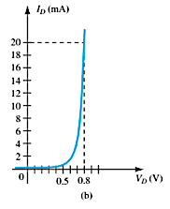
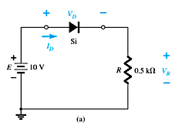

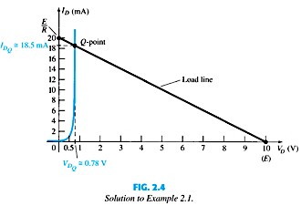

LOAD-LINE ANALYSIS

Slide 6
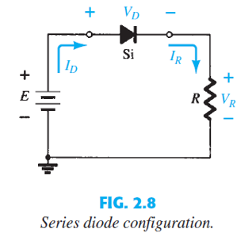
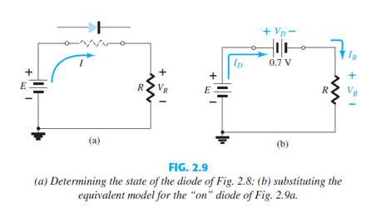
SERIES DIODE CONFIGURATIONS

Slide 7
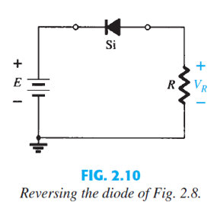
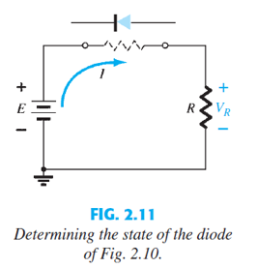
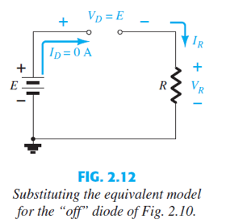
SERIES DIODE CONFIGURATIONS

Slide 8
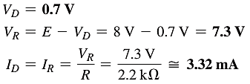
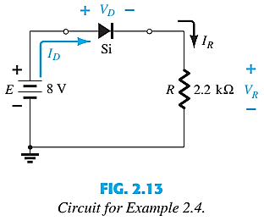
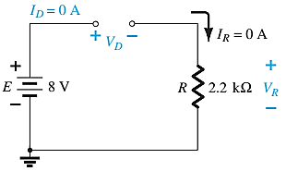

SERIES DIODE CONFIGURATIONS

Slide 9

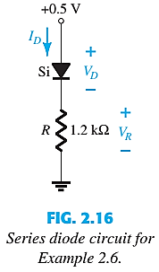
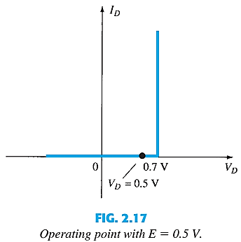
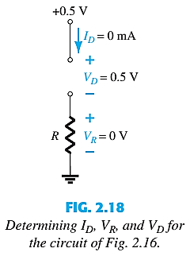
SERIES DIODE CONFIGURATIONS

Slide 10
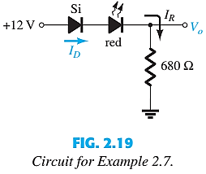
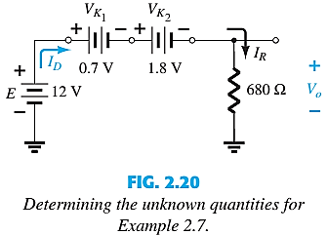

SERIES DIODE CONFIGURATIONS

Slide 11
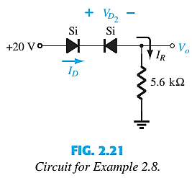
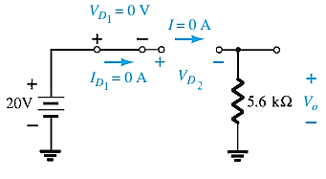


SERIES DIODE CONFIGURATIONS

Slide 12
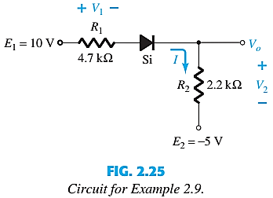
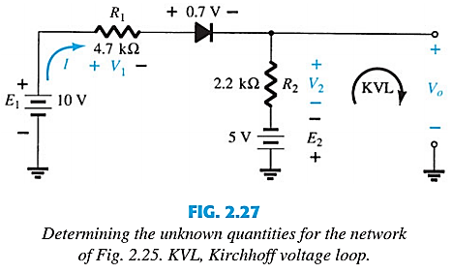



SERIES DIODE CONFIGURATIONS
Applying KVL,

Slide 13
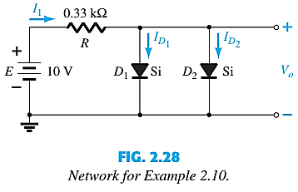
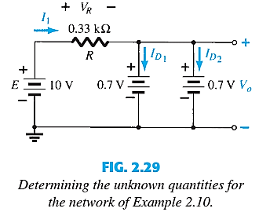



SERIES-PARALLEL CONFIGURATIONS

Slide 14
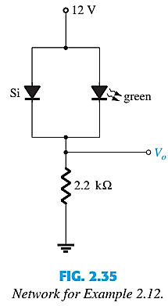
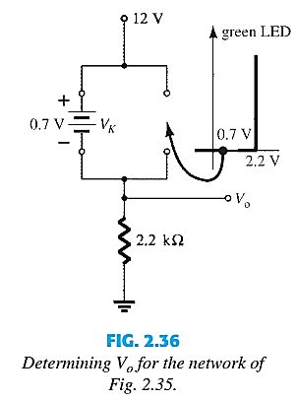

SERIES-PARALLEL CONFIGURATIONS

Slide 15
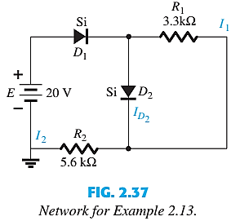
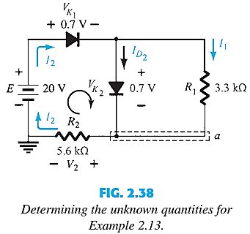



SERIES-PARALLEL CONFIGURATIONS

Slide 16
Thank You

